Slide 1
Why use microcontrollers?
Essentially needed by the problem statement.
Explicit degree of control.
Helps us add our own functionality.
The only method of information control onboard the actual probe.
Allows you to format your data as you like.
Which microcontrollers should you use?
Generally, there is no cap on this. Teams use everything from Arduino Nano to small versions of STM32.
Choice of microcontroller depends on your ease of handling the interface, as also your familiarity with the intricacies.
Microcontroller coding will use fundamentals rather than predefined functions. When you run into a road block, it’s your knowledge of serial communication and machine level code that solves the problem. Not ChatGPT.
Pick two fundamental microcontroller choices along with FSW and start working on it. The more your familiarity, the lesser problems you might encounter.
This section is equally FSW as Telemetry.
Our choices were Arduino and Teensy, the former for ground testing and the latter for actual integration.

Slide 2
Microcontroller interfacing basics
Baud rate specification, type of data transmission (SPI, UART), ASCII or HEX?
The above parameters are used when setting up communication in the code.
Using the SOP from the last section, connect the XBee to the microcontroller using breakout board and not breadboard. Ensure that no connection has been wrongly made before plugging in.
Basic code variable declarations.
(For Arduino) The dreaded SoftwareSerial and why to use it?
Strings or data literals?
Arduino and Teensy run the ‘setup’ loop once, and the ‘loop’ repeatedly. Onboard, this second loop will run again and again, I’ve got no way to control it.
How do I arrange the flow of this loop?
PACKET generation.

Slide 3
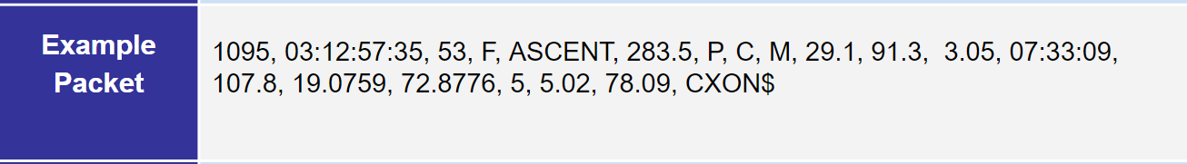
Serial Communication Rationale
In a XBee, data is sent serially via UART.
Arduino or Teensy uses the same protocol to communicate with PC. Since something like arduino works on only one hardware serial port, we convert a pair of digital pins to serial pins.
The packet has a specific format, which, to us, seems like normal keyboard characters. However, microcontrollers interpret this differently. (ASCII)
To generate a packet, we have two options. One is String, the other is character array.
Arduino will NOT serially output a String. It will however accept char array.
This discovery took us 15 days.
To generate a packet, you will have to convert
1. int to char using dtostrf
2. words(alphabets) to char array
3. Concatenate these two forms to the original packet format.
4. Serial OUT this entire CHAR array.

Slide 4
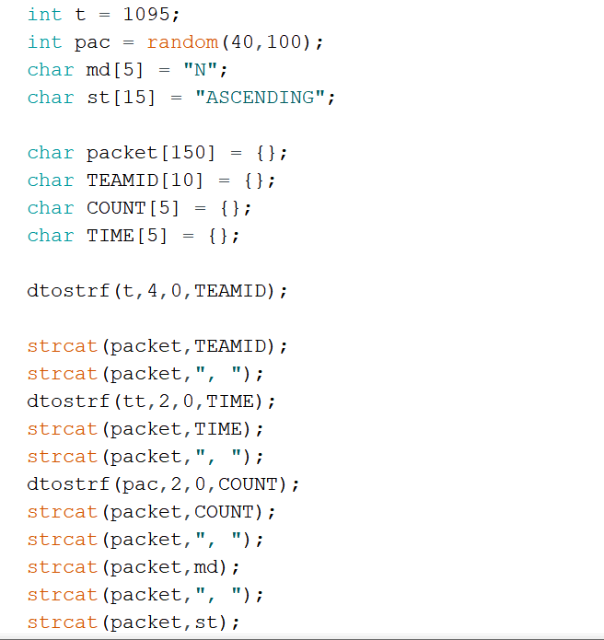
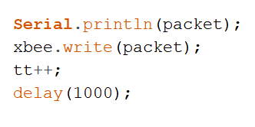
Example Packet Generation Code
Eventually, all our output packets will be char arrays. These same will be
Received as char arrays. To make them readable, we have to
Convert them back. For this you should know which field is what
This is where you synchronize packet length from TX to RX.
To make the received packet readable to onboard microcontroller, parse
Entire packet, extract fields, convert them back to original format.
Hence, entire packet process is similar to encryption-decryption.

Slide 5
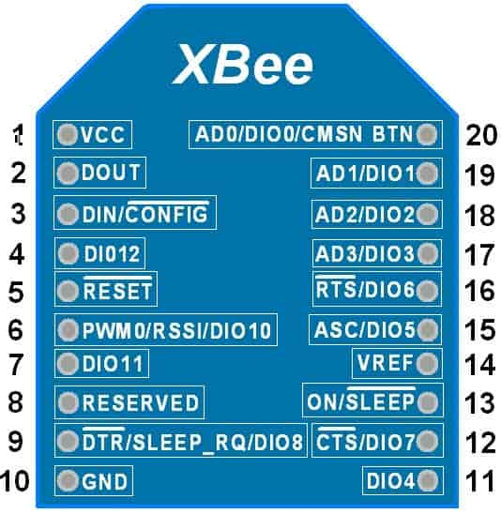
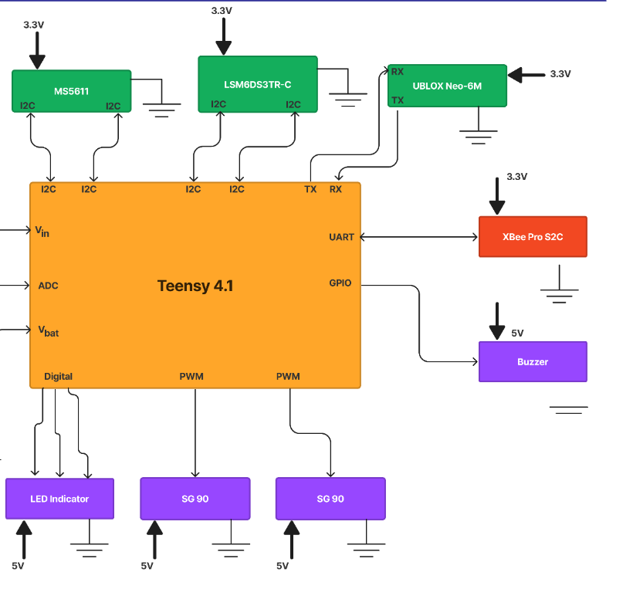
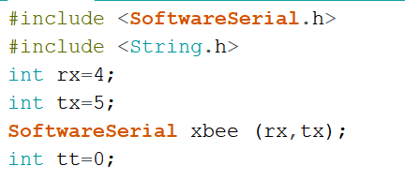
Wiring Diagrams

Slide 6
Future pending work
Packet generation has been completed. Packet reception is like 30% done.
Checking whether the packet reception SOP till now works, or we can find a more computationally efficient way of iterating through the packet.
Converting the packet back to original field states.
Using one microcontroller sent packet to control functions using the second microcontroller.
Serially outputting received packet to the GUI and displaying every field’s value. Also, proper generation of a csv file.
This is the only remaining section of Telemetry. Hence, it will be our 1st priority.

